Slide 1
SolutionPack for Cisco MDS Nexus Watch4net Official Content v 1.0
2013-02-21 -- A.Lemay – Initial version

Slide 2
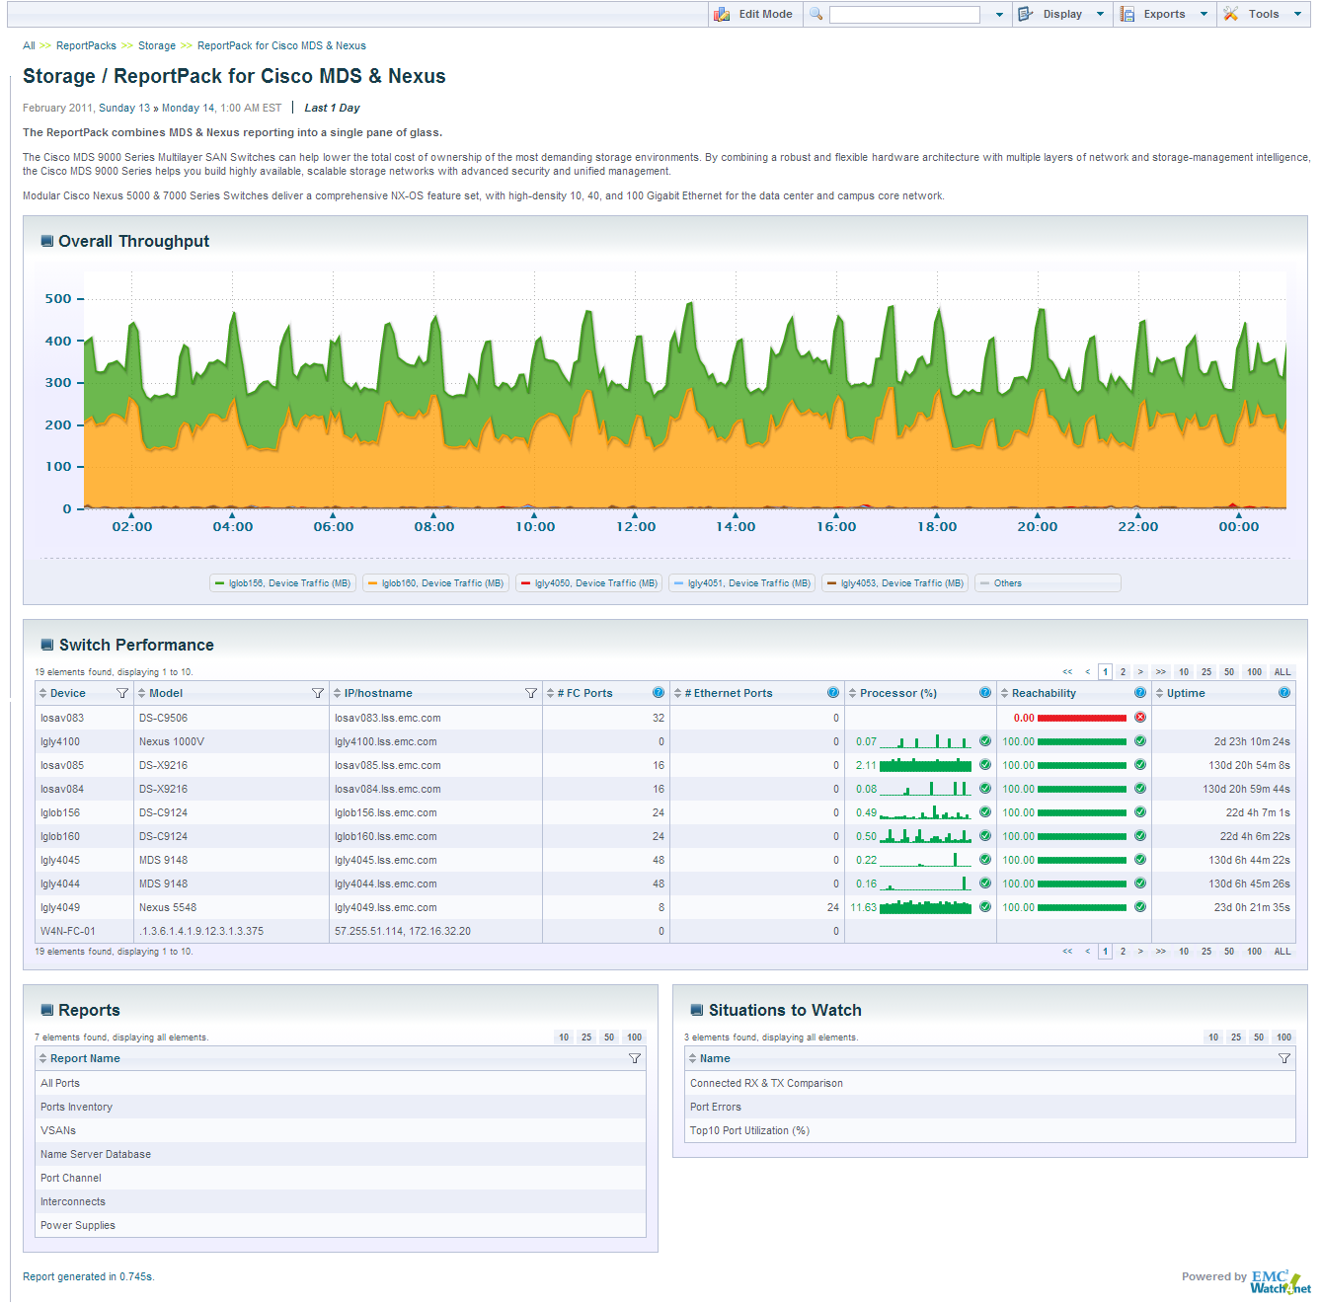
Global Dashboard
Multi MDS Performane Overview
MDS Inventory and drill-down
Proactive reports

Slide 3
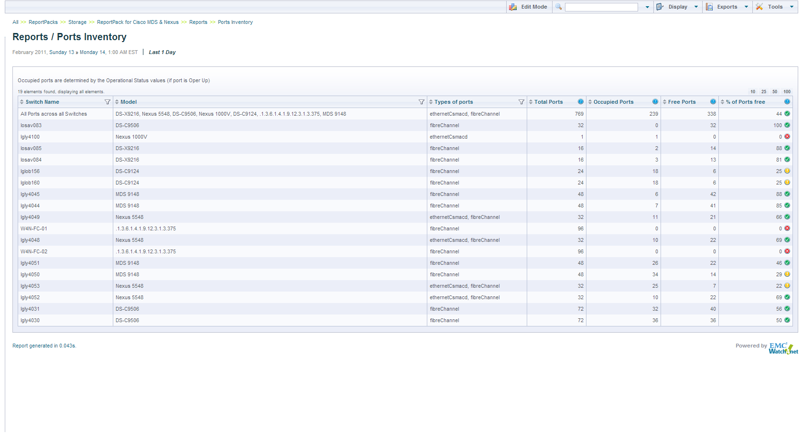
Multi MDS Port Inventory
Real-time status
Drill down to see Ports status and performance

Slide 4
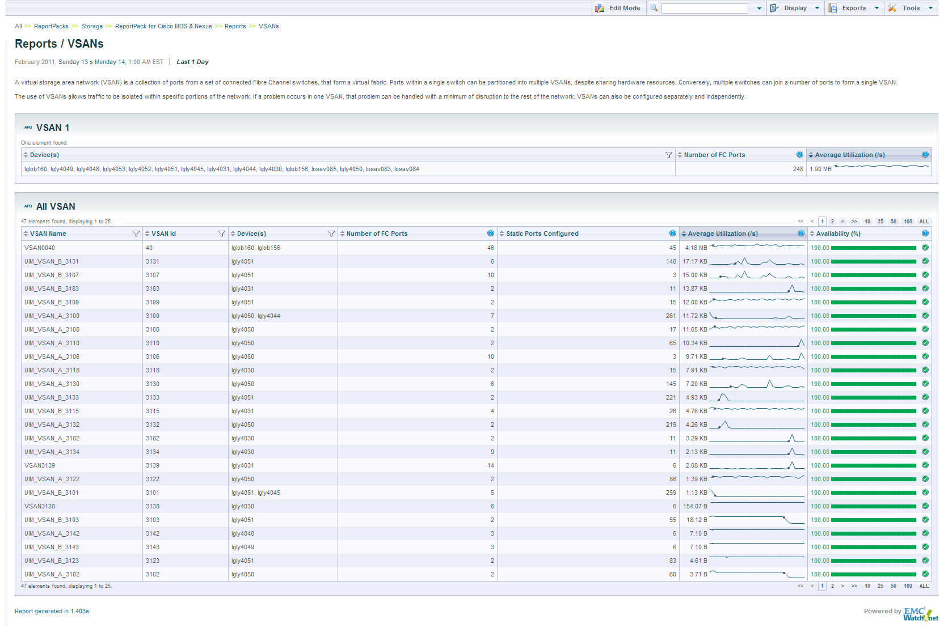
VSAN Reporting
Related devices
Quick look on the performance and availability history

Slide 5
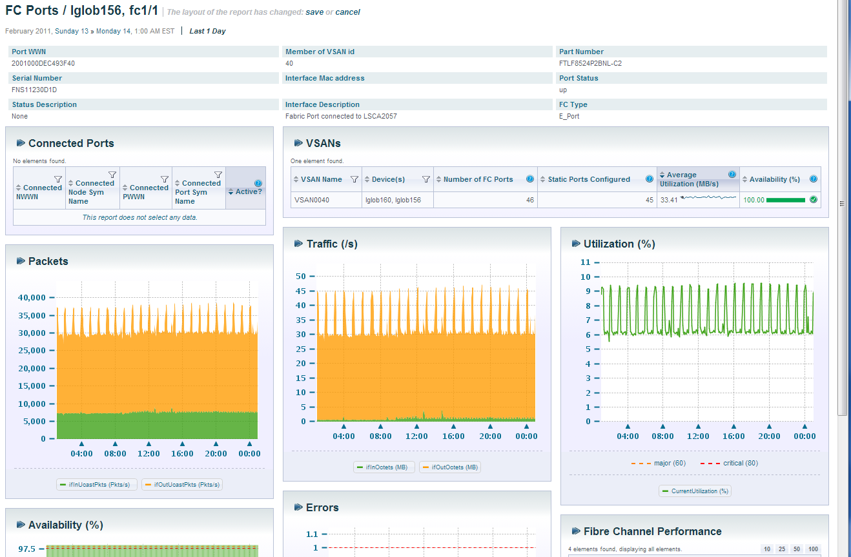
Live & Historical Port Statistics
Related VSAN details
Availability History

